Slide 1


Programa Ambiente em Ação
Environment Programme in Action
Number THREE

Slide 2



Bilateral Relations Fund
EEA and Norway Grants 2014-2021
Conference
Breaking the Barriers in a Circular Economy 24 and 25 of September 2019 | Oslo, Norway
Organized by Innovation Norway
Environment Programme in Action
Number THREE

Slide 3
This event was part of the Oslo Innovation Week, and took place from 24 to 25 September 2019.
The initiative aimed to promote partnerships or funding for circular economy projects between Norwegian and international entities, researchers and socio-economic agents, in particular in the following key areas:
Reducing material and resource inputs;
Maintaining the value of products, materials and resources for as long as possible;
Minimizing the generation of waste;
Replacing non-renewable resources with biomass;
protecting oceans and land from waste and litter by remediating existing concentrates, mitigating new pollution and developing biodegradable bio plastics.
For the Environment Program, this event was of particular interest to potential applicants for funding in the area of ​​plastics, marine litter and construction, particularly for the development of projects under:
Call # 1 - Deposit refund system for beverage and can bottles;
SGS # 1 - Prevention and awareness of marine waste reduction;
Call # 2 - Circular Economy in the Construction Sector;
SGS # 2 - Development of standards in the Construction Sector that promote Circular Economy.
Environment Programme in Action
Number THREE

Slide 4
Agenda of the event
(to see click hear)
The first day of the event was dedicated to a Networking Evening.
The second day offered, in the morning, a range of introductory lectures on the themes of the event, an interactive discussion (through Mentimeter) and a pitching moment, with the afternoon being dedicated to bilateral meetings - B2B meetings.
A Portuguese entity was invited to participate in pitching (CIM Região de Coimbra).
Participants
The event had a total of 224 participants from 23 countries:
108 from Norway or Iceland;
115 from European Union countries;
7 from other countries (US, Pakistan, Peru and Singapore).
Of note:
Too Good to Go
N2 Applied
Metabolic
Environment Programme in Action
Number THREE

Slide 5
Too Good to Go
Name of the partner: Too Good To Go
Abbreviation: Too Good To Go (2Good 2Go)
Address: Lindgreens Allé, 9, 1, 2300 Copenhagen S
Legal status: Private company
Legal Representative: Mette Lykke (CEO)
e-mail: Jamael Kudratt, press@toogoodtogo.com
Department: Press and communication
Website: https://toogoodtogo.pt/pt
Statistical Data:
- Nº of employees: more or less 400 employees
- Working in 14 countries (Austria, Belgium, Denmark, France, Germany, Italy, Norway, Poland, Portugal, Spain, Sweden, Switzerland, Netherlands, United Kingdom)
- Partners: 29 265
- Nº of applications downloaded (Apps): 16 million
- 21,4 million meals saved
- Reduction of 53 602 tones of CO2
- Activity Sector: Agricultural, food and other services.
Mission:
Too Good To Go fights food waste by offering an application that functions as a marketplace for surplus food. Around 5000 meals are saved every single day in Norway.
Too Good To Go was founded in Denmark and quickly moved to Norway the same year. Since 2016 it has grown to more than 12 countries around Europe and more than 20 000 000 meals has been saved.
With over 300 employees Too Good To Go is no longer "just" a startup but a successful company with 1 goal - to keep food from being wasted in the bin.
Technical Areas:
Circular Economy (reuse, remanufacturing and product life cycle extension).
Dematerialization (all food orders are made by the application ‘Too Good to Go’)
Environment Programme in Action
Number THREE

Slide 6
N2 Applied
Name of the Partner: N2 Applied AS
Abbreviation: N2
Address: Dronning Eufemias gate 20, 0191, Oslo
Legal Status: Private company
Legal Reprentative: Rune Ingels e Grete Sønsteby (CTO, CEO &Co-Founders)
e-mail: Trond Lund, trond.lund@n2applied.no
Department: Business Development
Website: https://n2.no/
Statistical Data:
- Founded in 2010
- Technological Startup
- Activity Sector: Organic Agriculture
- Type of funding: Venture Capital
- Technological breakthrough in Nitrogen
Mission:
N2 Applied enable farmers to recirculate nitrogen and produce fertilizer on the farm - reducing ammonia losses, laughing gas production and methane emissions from agriculture while being profitable for the farmer. The company's plasma reactor removes nitrogen from animal feces, allowing farmers to produce their own fertilizer with lower greenhouse gas (GHG) emissions, more resource efficiency and lower costs. This type of fertilizer will complement traditional fossil fuel-based industrial fertilizers, thereby changing the conventional linear value chain to a more circular mode.
Technical Areas:
Sustainability and profitability
Circular Economy (recycling, reduce and remanufacturing)
Low carbon economy and climate change mitigation and adaptation (reduction of the GHG emissions, efficient agricultural production and renewable energies)
Environment Programme in Action
Number THREE

Slide 7
Metabolic
Name of the partner: Metabolic
Abbreviation: M
Address: Meteorenweg, 280 Amsterdam, 1035RN
Legal Status: Private company
Legal Representative: Eva Gladek (Founder&CEO)
E-mail: Kate Black, info@metabolic.nl
Department: Press and Communication
Website: https://www.metabolic.nl/
Statistical Data:
Founded in 2012
Nº of employees: 11 to 50 employees
Activity Sector:
Consulting (Corporate, NGO, Government, Cities and Regions)
Think Tank (working in partnership with universities or other academic institutions and do research based on real-world experiences on subjects such as sustainability)
Venture capital startups (Metabolic helps in the setting up of venture capital companies doing the bridge between the entrepreneurs and the investors and also providing financial advices)
Mission:
Metabolic’s overarching mission is to change the global economy to a fundamentally sustainable state. A new economic model is necessary: one that ensures the wellbeing of all people and allows organizations to thrive without transgressing the safe boundaries of the earth’s natural systems. And we don’t have much time. Metabolic advises governments, businesses, and NGOs on how to adapt to a fast-changing global context, while creating disruptive solutions that can dramatically shift how the economy functions. We crunch data, provide strategies and tools, build pilots, and create new ventures that develop scalable solutions to critical problems. Core to achieving our mission is the transition to an economy that is regenerative and ‘circular’ by design.
Technical Areas:
Sustainabilty consulting, Systems design, Urban&amp, Industrial Strategy, Clean technology, Food Systems, Systemsthinking, Industry analyses, Circular Economy Urban Metabolisms.
Environment Programme in Action
Number THREE

Slide 8
The Portuguese presence in this event had 8 elements:
Academy - Instituto Politécnico de Leiria and Universidade do Porto.
NGO – WWF Portugal.
Companies – Ecoreverse, FirstReason and Tellus.
Regional Administration – CIM Região de Coimbra and CCDR Alentejo.
Two representatives from EEAGrants also participated:
Blue Growth Program: DGPM
and
Environment Program:
SG-MATE.
The Portuguese participation resulted in 21 scheduled B2B meetings, to which 32 were added during the event and canceled 1, making a total of 52 bilateral meetings (average of 6.5 meetings per participant).
From these meetings resulted:
12 potential partners for an application for project funding under the 'Environment Program', especially for Call # 2.
17 potential partners for other joint projects.
Environment Programme in Action
Number THREE

Slide 9
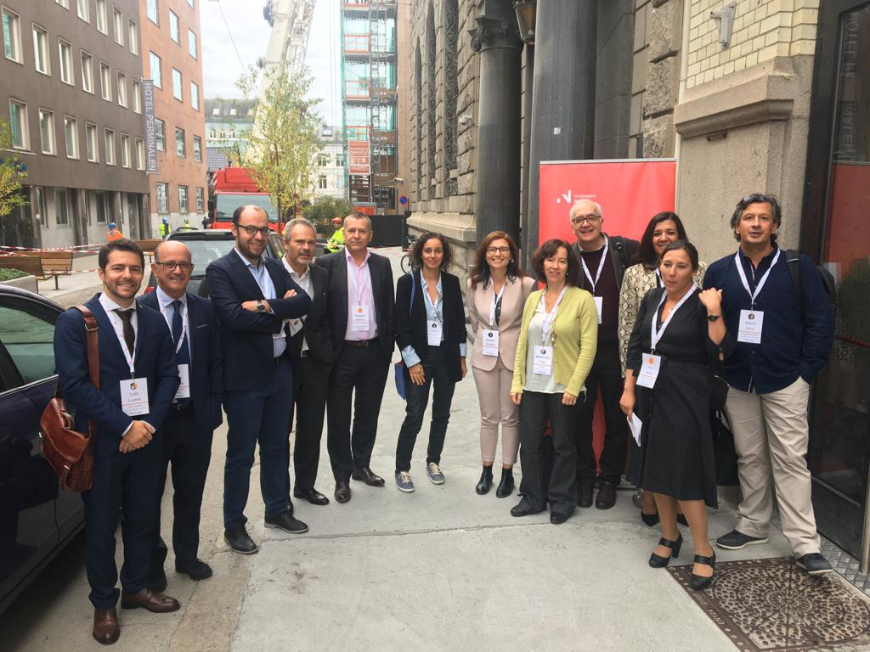
The event met the expectations of the Portuguese participants, and the comments received were mostly positive.
More information available at:
https://breaking-barriers.b2match.io/
Environment Programme in Action
Number THREE

