Slide 1
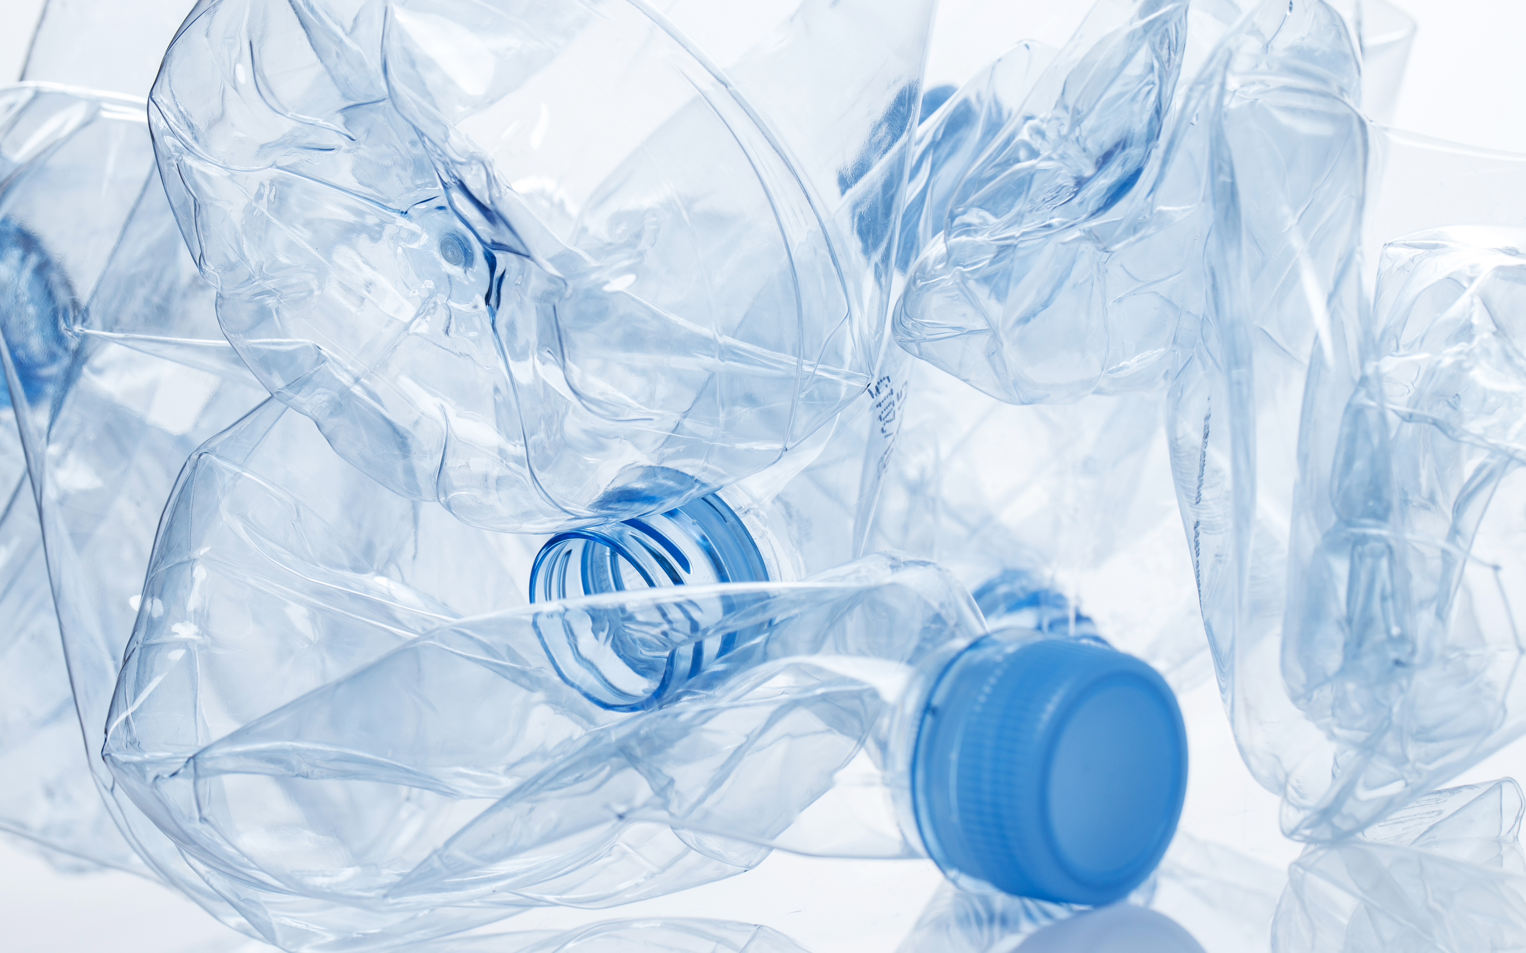



Environment, Climate Change and Low Carbon Economy Programme
OESTE +RECICLA PROJECT
EEA Grants 2014-2021
Oeste +Recicla Project| Intermunicipal Community of the West
10/07/2020

Slide 2

OESTE +RECICLA PROJECT

Slide 3

OESTE +RECICLA
PROJECT PROMOTER AND PARTNER
Promoter of the Project
Portugal
Intermunicipal Community of the West
Partner
Norway
Empower
Oeste +Recicla
Working together for a green and competitive Europe

Slide 4
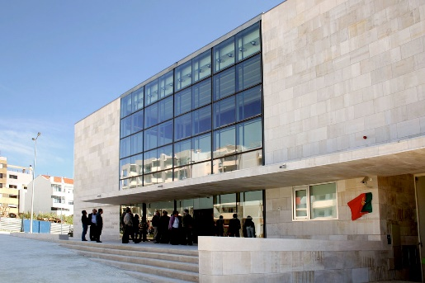
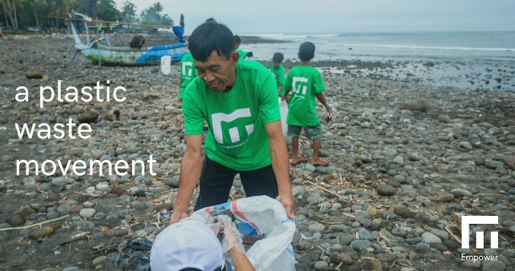
OESTE +RECICLA
PROJECT PROMOTER AND PARTNER
Intermunicipal Community of the West
Empower
It comprises 12 Municipalities: Alcobaça, Alenquer, Arruda dos Vinhos, Bombarral, Cadaval, Caldas da Rainha, Lourinhã, Nazaré, Óbidos, Peniche, Sobral de Monte Agraço and Torres Vedras.
It´s a public entity with the mission of contributing to the sustainable development and the improvement of the quality of life of its municipalities.
Its vision is to be an Intermunicipal Community of excellence in public management oriented towards quality, innovation, efficiency and effectiveness, which invests in partnerships and in the management of institutional networks.
Based on the idea of using new technologies to promote circular economy, Empower's vision is to enable people to create a better and cleaner world..
Its’ goal is to build a global ecosystem of plastic waste based on the same philosophy of the Norwegian bottle deposit system
By giving value to plastic waste, we can prevent the flow of plastic into the environment and encourage the collection of waste in an economical way
By taking digital inventories, it also ensures that most of the collected plastic will be reused and recycled..

Slide 5

OESTE + RECICLA
PROJECT DESCRIPTION
Europe produces about 58 million tonnes of plastic per year
Portugal contributed with almost 370 thousand tons
An average of 31kg per person, which is above the European average.
West Region: 11 060,34 tons of plastic
3% of the national plastic
Recycling rate of plastics in the packaging of consumer products
2016 - approximately 41,8 %
2017 – approximately 34,9%
(data according to Eurostat)

Slide 6



OESTE + RECICLA
OBJECTIVE OF THE PROJECT
To increase the application of the circular economy principles in specific sectors, in production and in consumption
To increase the rate of recycling of plastics in the packaging of consumer products, contributing to the objectives of the Financial Mechanism of the European Economic Area 2014-2021, the Environment Program and to the goals outlined in national policies articulated with local and regional strategies.
HOW?
Through the implementation of a system for deposit and return of plastic bottles in all Municipalities of the West Region, involving a Norwegian partner - Empower
OPERATOR OF THE PROGRAMME
PROJECT
PROMOTER
PARTNER
Secretary General of the Environment and Climate Action
Intermunicipal Community of the West
(OesteCIM)
Empower

Slide 7

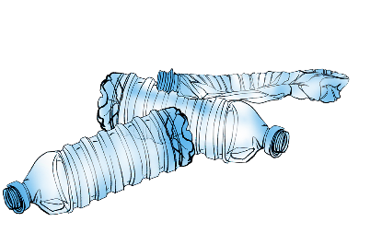

OESTE + RECICLA
INCENTIVE SYSTEM – AN INNOVATIVE AND ORIGINAL PROJECT
What is it?
Awarding a prize to the final consumer for the return of bottles made of non-reusable plastic.
The bottles will be sent for recycling and for the production of high quality recycled material, compatible with the necessary requisites for incorporation into the production of new beverage bottles.
Maximizing the circularity of recovered materials.

Slide 8
OESTE + RECICLA
INCENTIVE SYSTEM – AN INNOVATIVE AND ORIGINAL PROJECT
The refund system in the West Region will be made through 3 types of incentive:
Contribution to the donation to associations that support environmental sustainability and social inclusion
(promoting environmental sustainability and social inclusion)
Contribution to use in supermarkets, namely in superstores.
(promoting family economics)
Contribution to the use of public transport, namely social passes
(promoting sustainable mobility)
1
2
3

Slide 9
OESTE + RECICLA
SPECIFIC OBJECTIVES
5) Develop a market study on existing solutions and equipment
3) Develop an action plan to implement a pilot project based on the deposit refund for plastic bottles from the Western Region
2) Organize a field trip to Norway to learn about the donor country's refund system
1) Develop a diagnostic study on the State of the Art of the Deposit Refund System for plastic bottles in close collaboration with our Norwegian partner
4) Design, implement and test, through the development of a pilot project in the West Region, the future incentive system for the return of non-reusable plastic bottles, making use of our Norwegian partner´s experience.

Slide 10
OESTE + RECICLA
SPECIFIC OBJECTIVES
10) Develop the project's communication plan
8) Place 30 pieces of equipment in the 12 municipalities of the West
7) Purchase equipment and solutions through public procurement
6) Negotiate partnerships and develop protocols with beverage industry entities, retail companies, transport companies and environmental and social inclusion entities that will benefit from project donations
9) Implement collection through automatic equipment that allows the refund of the deposit in discount tickets at the supermarket, in the sale of tickets / passes and / or donations to social solidarity institutions

Slide 11
OESTE + RECICLA
SPECIFIC OBJECTIVES
13) Manage and asess the project and prepare the respective reports
12) Develop an event to disseminate deposit refund systems for bottles in the West Region and other regions of the country to promote the adoption of this kind of solutions by other public and private bodies
11) Hold seminars to present good practices to the twelve municipalities of the West Region, to it’s residentsand and to OESTECIM
14) Monitor the result indicators, namely tons of recycled plastic resulting from the project, number of beverage industry entities participating in the pilot system and number of retail sector companies participating in the system

Slide 12



Thank you!
Site: www.oestecim.pt
Facebook: www.facebook.com/OesteCIM/
Instagram: www.instagram.com/oeste_portugal/
YouTube: www.youtube.com/channel/UCSz33wQ-v70ZmsWCeB9LiNg
Twitter: www.twitter.com/ComunidadeOeste
Email: candidaturas@oestecim.pt
Operador do Programa
Promotor:
Parceiro

