Slide 1
cascaisambiente.pt

Slide 2
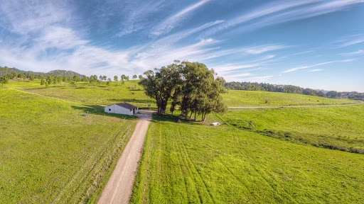
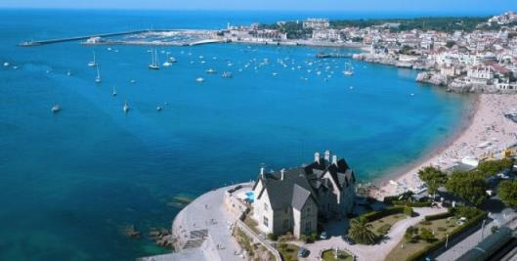




Cascais: a beacon of environmental innovation
+ The Cascais’ environmental policies prime for innovation and the valorisation of endogenous resources for the transition towards carbon neutrality.
+ We envision the reduction of families’ carbon footprint while improving their quality of life, and the competitiveness of organization in the circular and green economy.
+ We promote an integrated approach on waste collection, urban cleaning, climate change, energy climate change, urban green spaces, biodiversity and coastal areas.

Slide 3
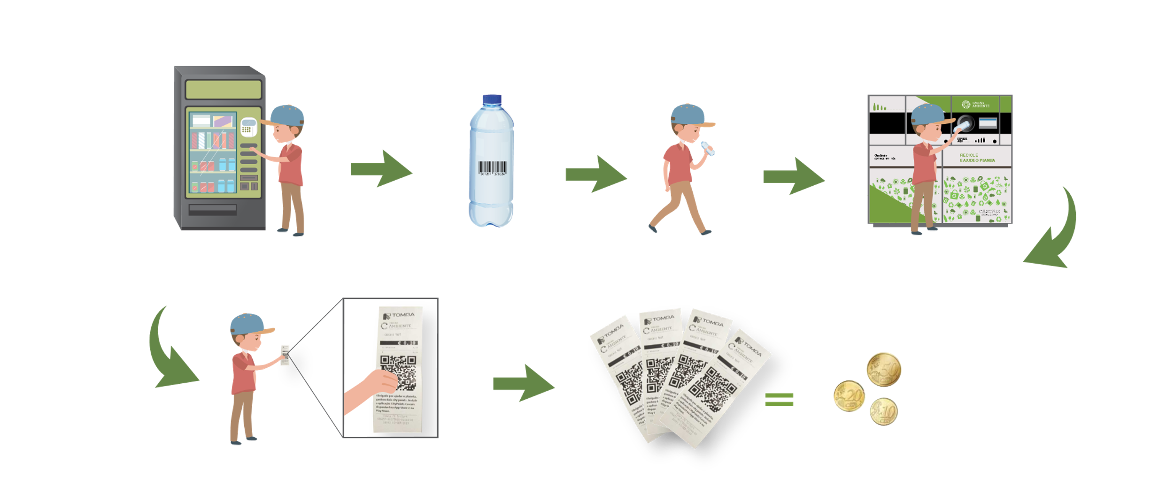
Ongoing innovation
+ Cascais Ambiente and Nova SBE University are testing an innovative beverage bottle deposit incentive scheme through a “gamification” process.
+ The deposit scheme in Cascais Ambiente is integrated with the “Citypoints Cascais” app which awards points to the user.
+ In Nova SBE University, the consumer has the option to have the deposit value or to donate the value to a Cascais NGO.

Slide 4
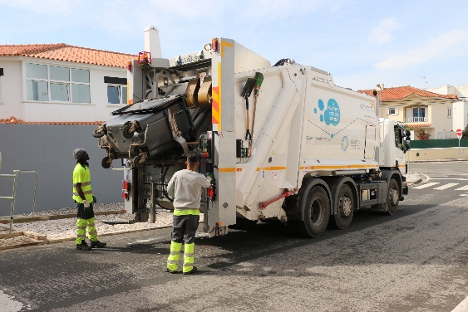
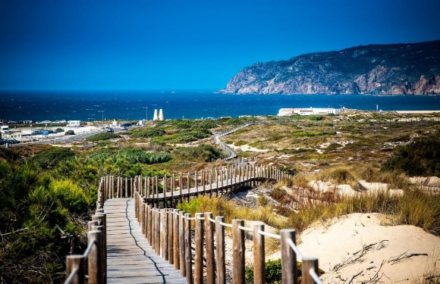
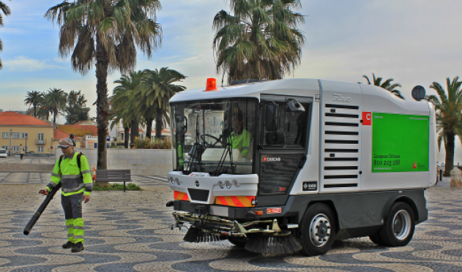
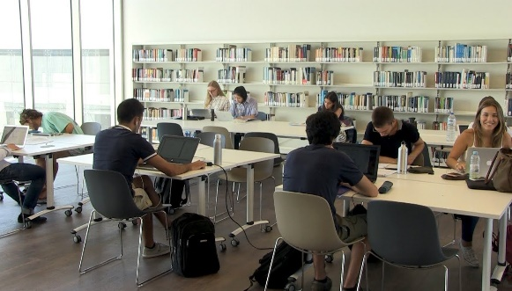
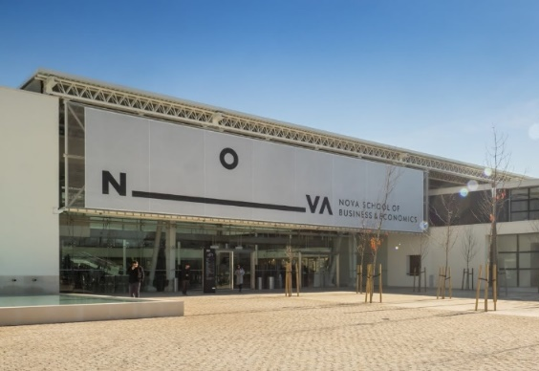
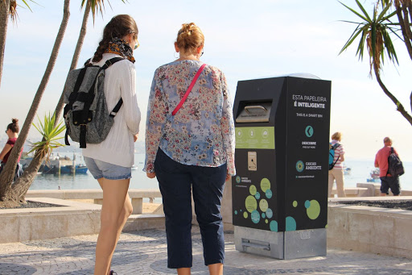
iREC – innovation in recycling
+ Aims to test in Cascais a beverage container deposit system directed to the general public and consumer with an incentive scheme, in partnership with the largest retailers operating in Portugal.
+ Promoted by Cascais Ambiente in Partnership with Nova SBE, the project will produce a relevant set of scientific information regarding deposit schemes adoption by the general consumers and stakeholders.
+ The project will engage the 200 000 Cascais’ inhabitants, as well as the over 1 500 000 yearly tourists and visitors.
+ Intended to become an innovation example which tests and foresees the mandatory deposit system implementation in Portugal by 2022.

Slide 5
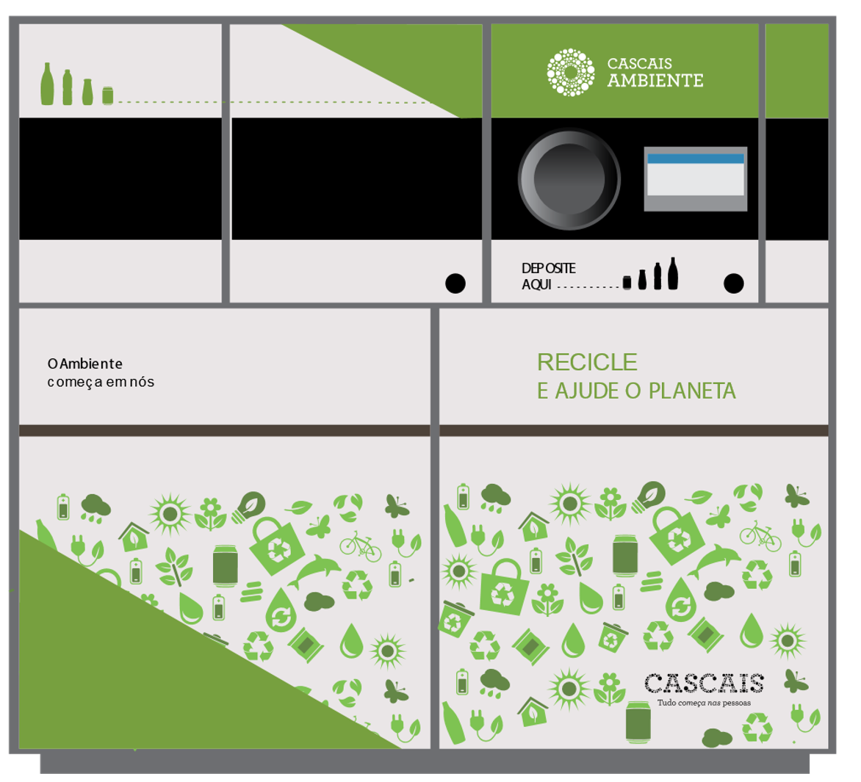






iREC – technological innovation
+ Instalment of 10 return vending machines in the main shopping centres and supermarkets in Cascais for 18 months.
+ Integration of the incentive scheme with the ”gamification” app to explore what are the most attractive incentives to users.
+ Project partners will have an effective integration within the project, contribution to the ecological footprint reduction of their products and by offering a relevant environmental solution to their costumers.

Slide 6
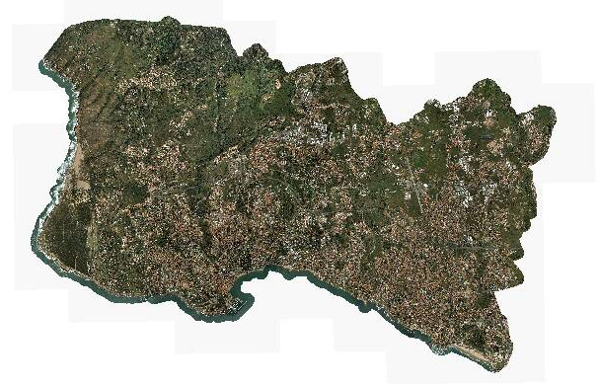

Slide 7
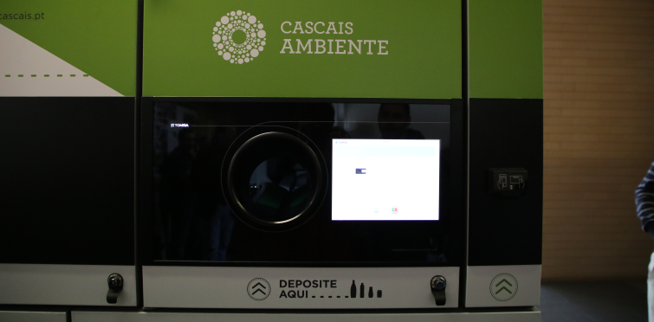

iREC – to study, to contribute
+ Assess and manage the system usage by consumers by registering KPI’s associated with the project’s impacts in recycling and consumer habits.
+ Broad Communication campaign to promote and create awareness towards the deposit adoption by consumers throughout the project.
+ Produce reports about the system’s adoption by users, its impacts and learnt lessons for replication.
+ To contribute for the MFEEE 2014-2021, particularly for the Environmental Program, for the Circular Economy Action Plan and the country’s waste management goals under the PERSU2020+.

Slide 8

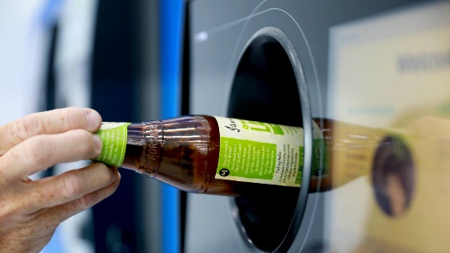

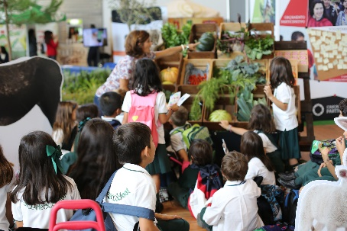
iREC – Work Structure
+ Activity 1: instalment and programming of 10 RVM machines (October 2020)
+ Activity 2: System management and waste transformation (October 2020 - January 2022)
+ Activity 3: follow-up and study of the incentive system’s performance by the consumers (October 2020 – January 2022)
+ Activity 4: Communication campaigns and stakeholder capacitation about the DRS (October 2020 – January 2022)
+ Activity 5: Knowledge share about circular economy and the project’s outputs (December 2021)

Slide 9
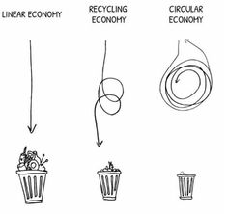
iREC – Innovation on recycling, accelerating the circular economy

